Slide 1

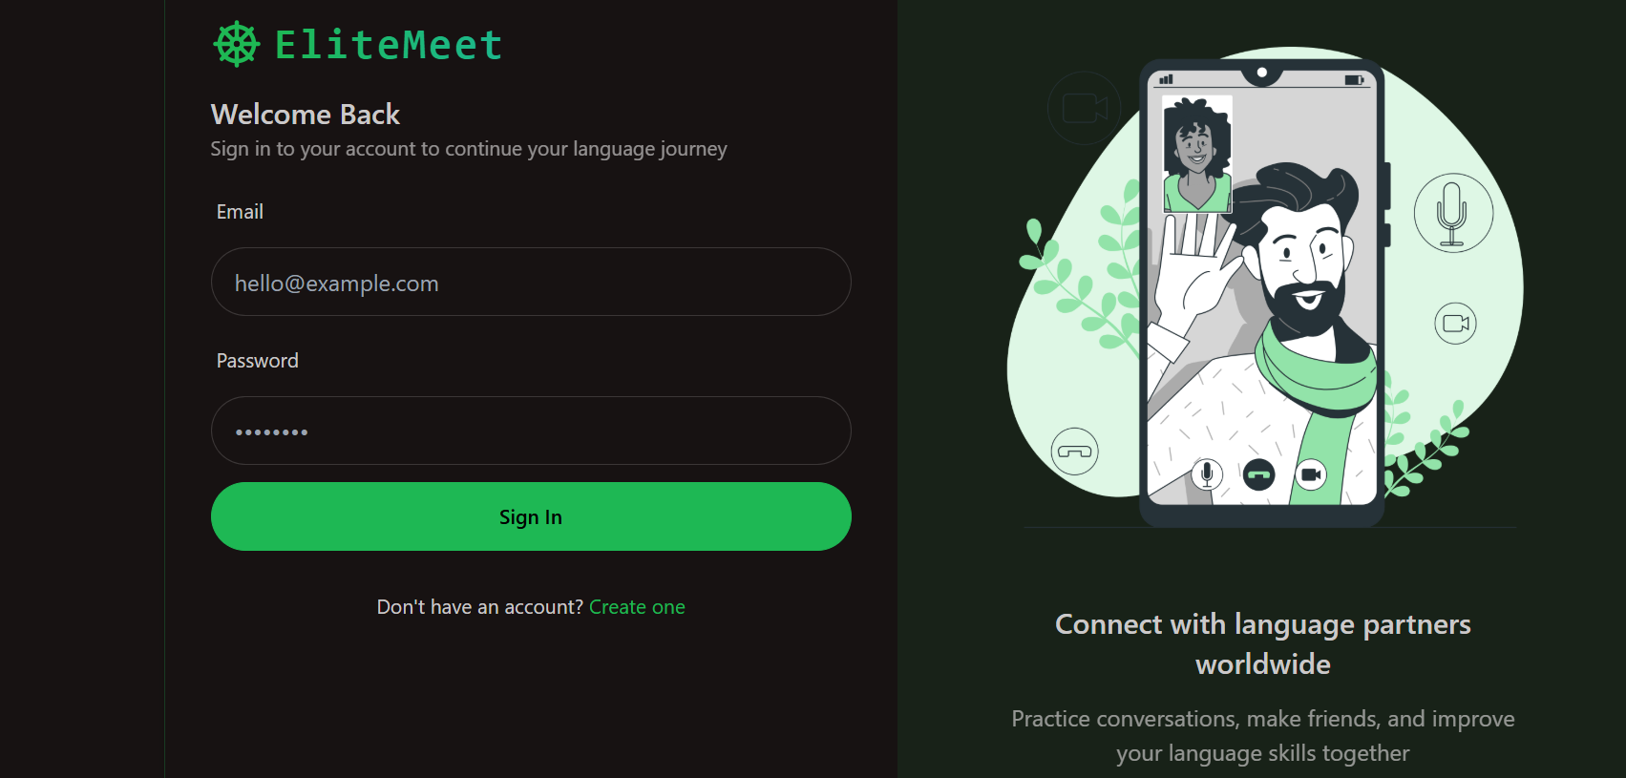
DAV INSTITUTE OF ENGINEERING AND TECHNOLOGY, PALAMU
ELITEMEET
B.Tech Final Year Project
Department of Computer Science Engineering
Submitted By: Group EndZone
Guided By: Mr. Vivek Sir
1
Notes:
Image source: https://academiainsider.com

Slide 2

GROUP MEMBERS
Bablu Pandey (21020440006)
Dolly Gupta (21020440008)
Nitish Gupta (21020440018)
Kajal Kumari (21020440012)
2
Notes:
Image source: https://academiainsider.com

Slide 3

OUR ESTEEMED FACULTY MEMBERS
1. Mr. Vivek Sir
(HOD & Assistant Professor)
2. Mr. Rahul Sir
(Assistant Professor)
3. Mrs. Jyoti Mam
(Assistant Professor)
3
Notes:
Image source: https://academiainsider.com

Slide 4
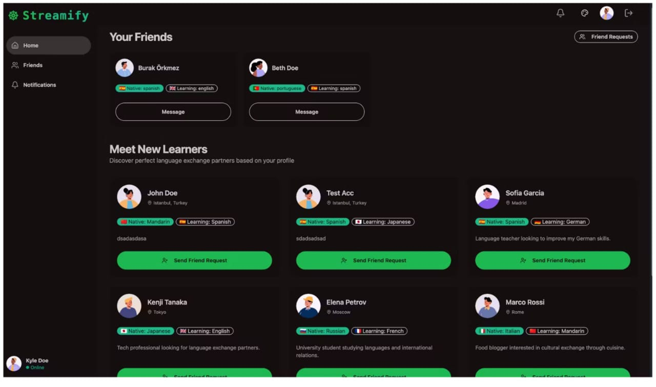
INTRODUCTION
Real-time one-on-one video communication via web browser.
Built using MERN stack and WebRTC for seamless streaming.
Secure login system with JWT-based user authentication.
Language exchange support for cross-cultural interaction.
Lightweight, responsive, and scalable communication solution.
4
Notes:
Image source: https://academiainsider.com

Slide 5
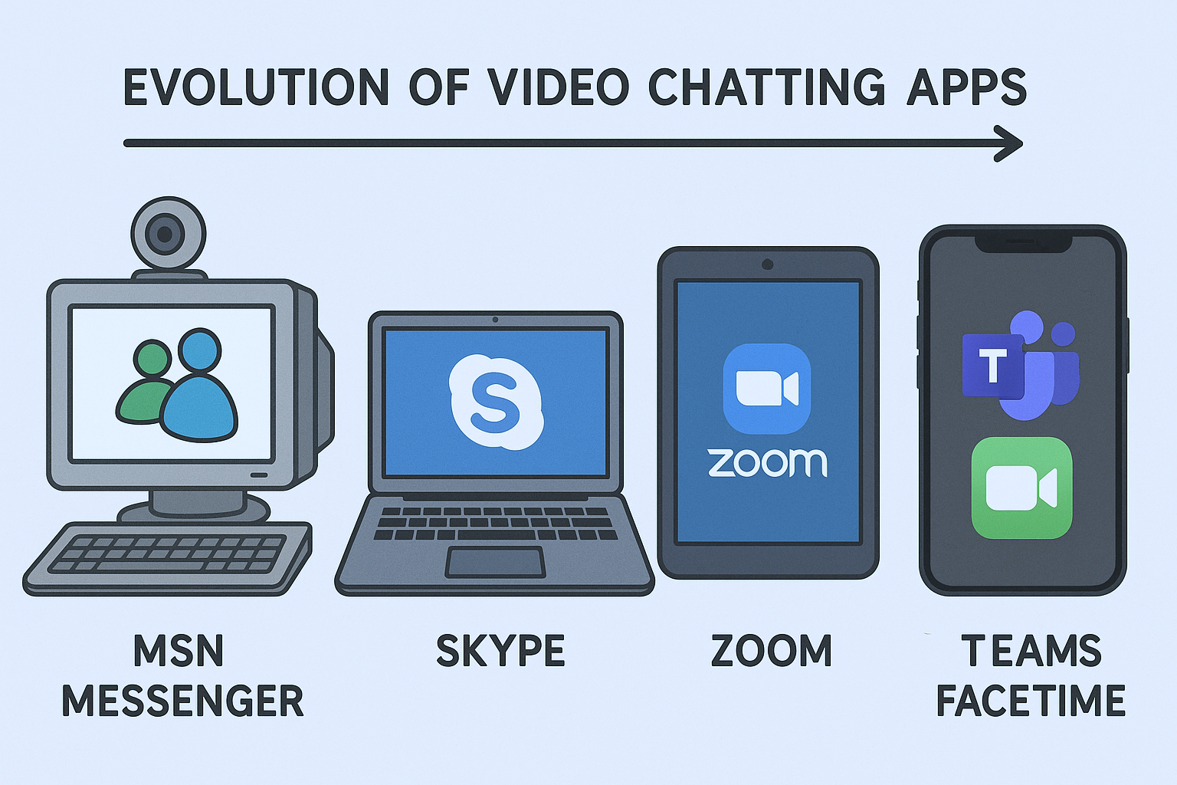
EVOLUTION OF VIDEO CHAT APPS
MSN Messenger kicked off the video chat revolution in the early 2000s.
Skype made long-distance video calling accessible and popular worldwide.
Apple’s FaceTime brought smooth, native video calls to smartphones.
Zoom rose as the remote work hero during the pandemic era.
AI and AR are transforming modern video apps into smarter, immersive platforms.
5
Notes:
Image source: https://academiainsider.com

Slide 6
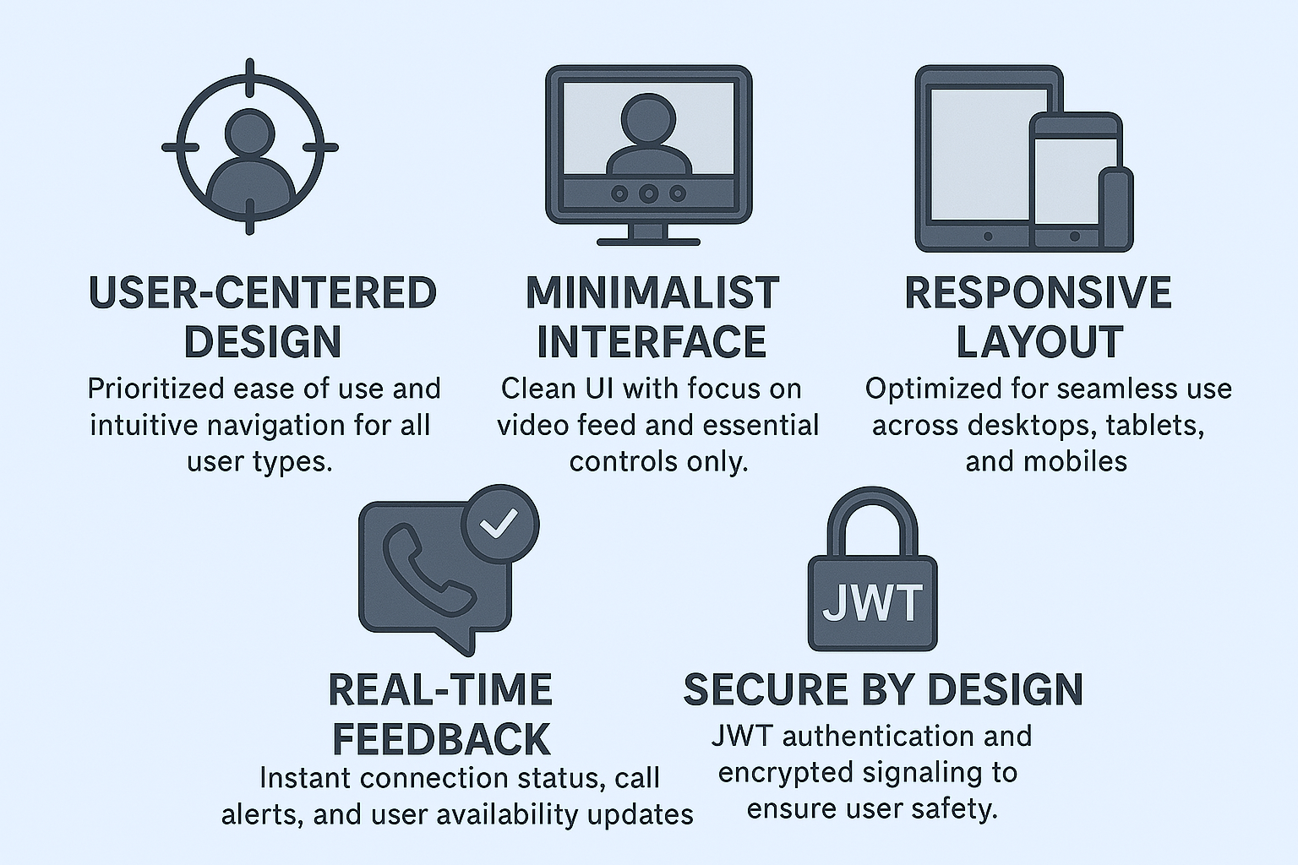
DESIGN PHILOSOPHY OF ELITEMEET
6
Notes:
Image source: https://carreirafacil.com

Slide 7
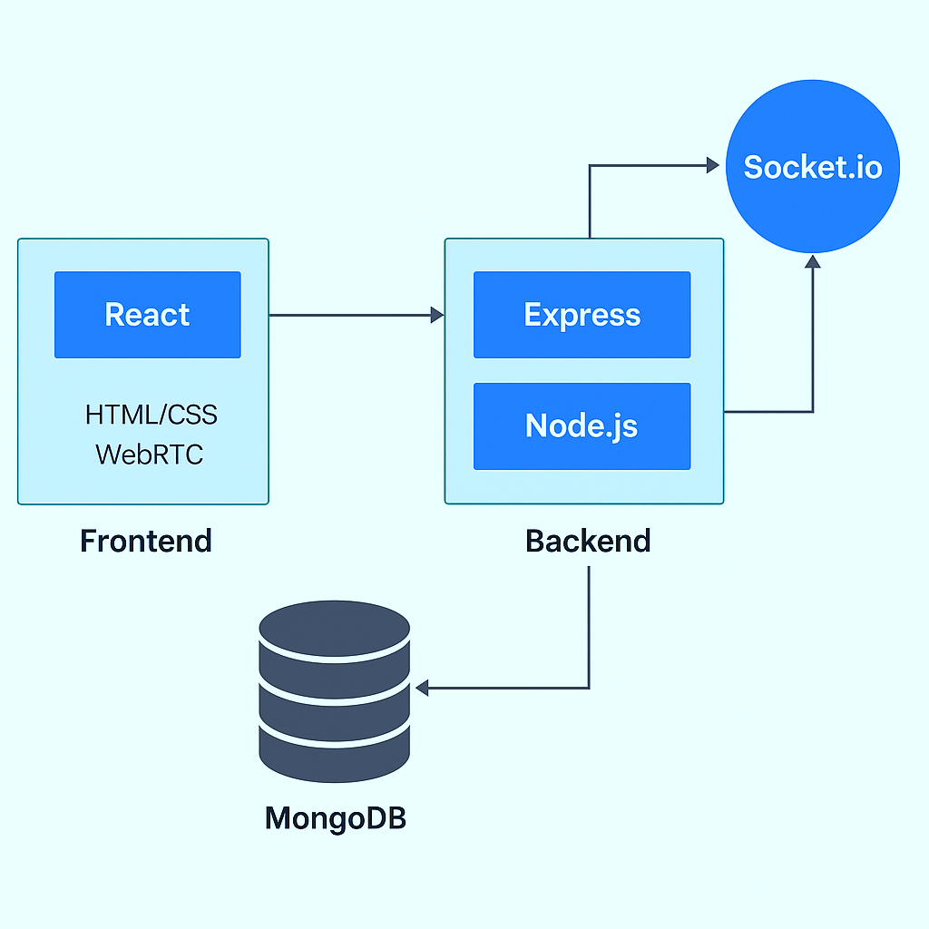
SYSTEM ARCHITECTURE
Frontend (React.js): Builds the user interface for video calls, chat, and user authentication.
Backend (Node.js + Express): Handles API requests, signaling, and session control.
WebRTC Integration: Enables real-time peer-to-peer video and audio communication.
MongoDB Database: Stores user data, chat history, and authentication tokens securely.
Socket.IO: Facilitates real-time communication and event broadcasting between users.
7
Notes:
Image source: https://www.apptivo.com

Slide 8
USER INTERFACE DESIGN
Clear, distraction-free layout focused on active video stream.
Floating call controls for easy access without blocking view.
Color-coded call status indicators (connected, ringing, ended).
Clean typography and intuitive icons for accessibility.
Mobile-first responsive layout ensuring seamless interaction on all screens.
8
Notes:
Image source: https://chisellabs.com

Slide 9
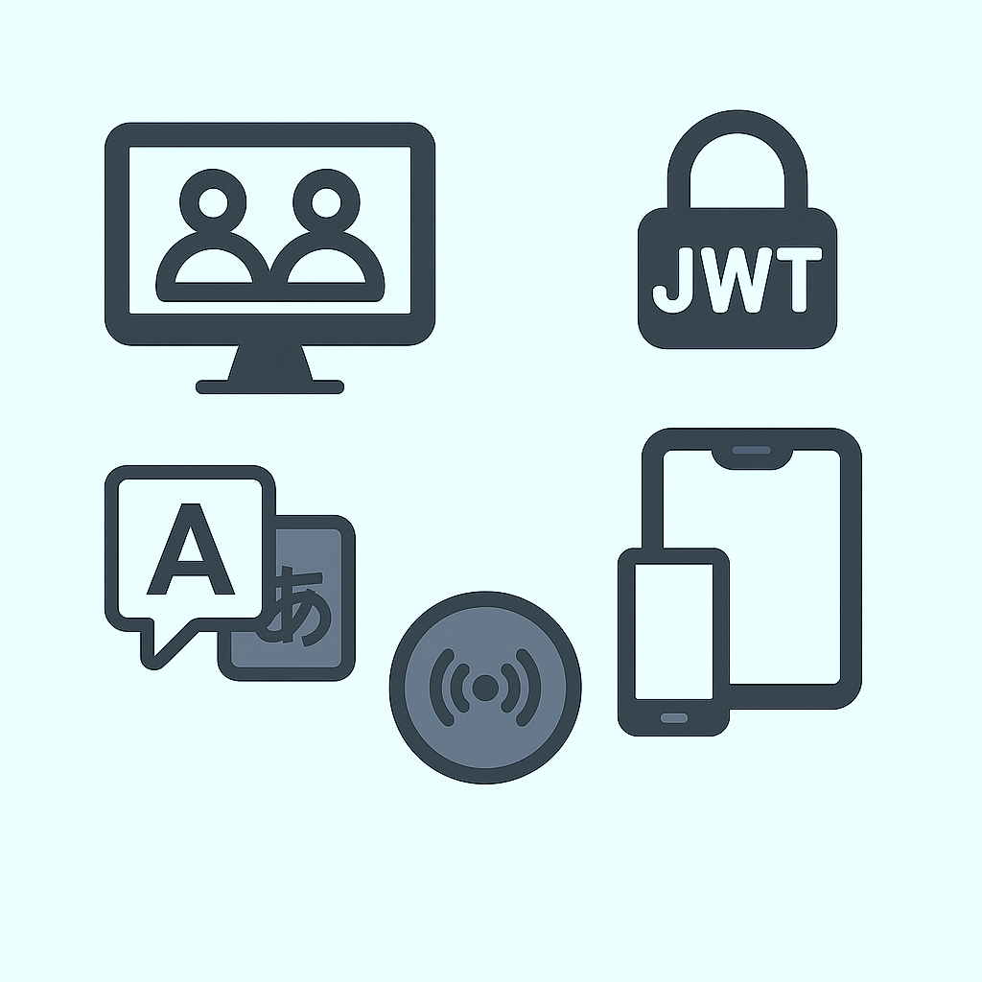
CORE FEATURES
One-on-One Video Calls – Real-time HD communication using WebRTC.
JWT Authentication – Secure user login and session handling.
Language Exchange Mode – Connect users based on language preferences.
Real-Time Signaling – Fast call setup using Socket.IO.
Responsive UI – Works smoothly across desktop and mobile devices.
9
Notes:
Image source: https://imgcdn.stablediffusionweb.com

Slide 10
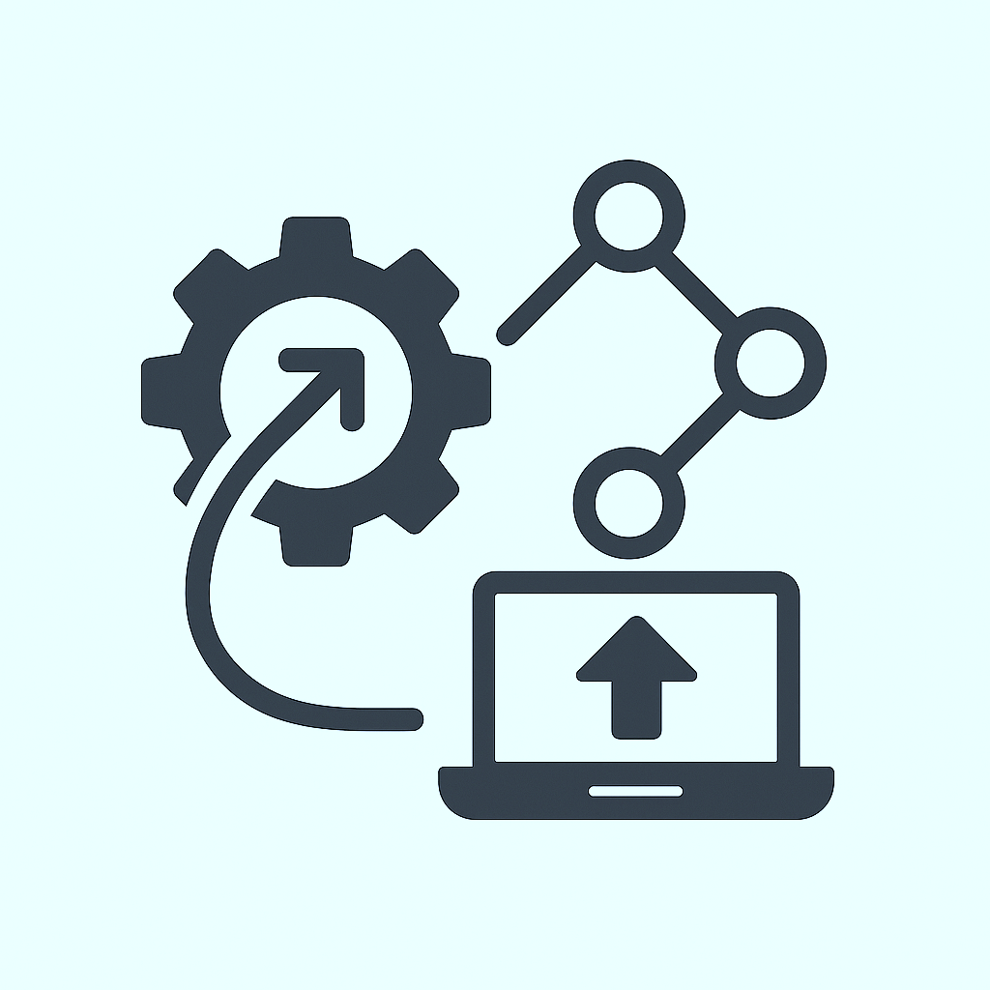
INTEGRATION AND DEPLOYMENT
Frontend–Backend Integration via REST APIs and WebSocket (Socket.IO) for real-time communication.
WebRTC Setup integrated for peer-to-peer media exchange and STUN/TURN server configuration.
JWT Token Flow connected across frontend, backend, and database for secure authentication.
MongoDB Atlas used for cloud-based storage and easy integration with Node.js backend.
Deployed on Render/Vercel with environment variables and CI/CD support for seamless updates.
10
Notes:
Image source: https://cdn1.byjus.com

Slide 11
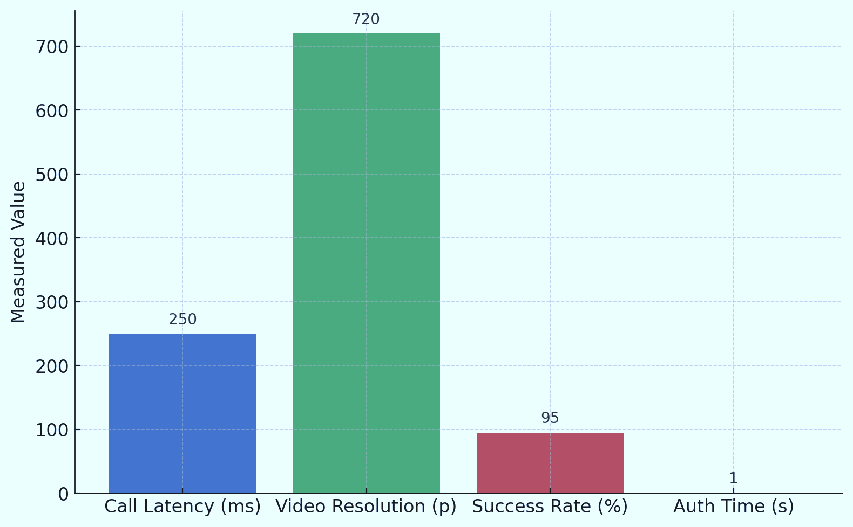
RESULT AND PERFORMANCE METRICS
Average Call Latency maintained under 250ms on stable networks.
Video Quality consistently achieved 720p resolution in peer-to-peer calls.
Connection Success Rate of over 95% across multiple test sessions.
Cross-Browser Compatibility verified on Chrome, Firefox, and Edge.
Authentication Time under 1 second using JWT on all tested devices.
11
Notes:
Image source: https://www.grassrootshealth.net

Slide 12
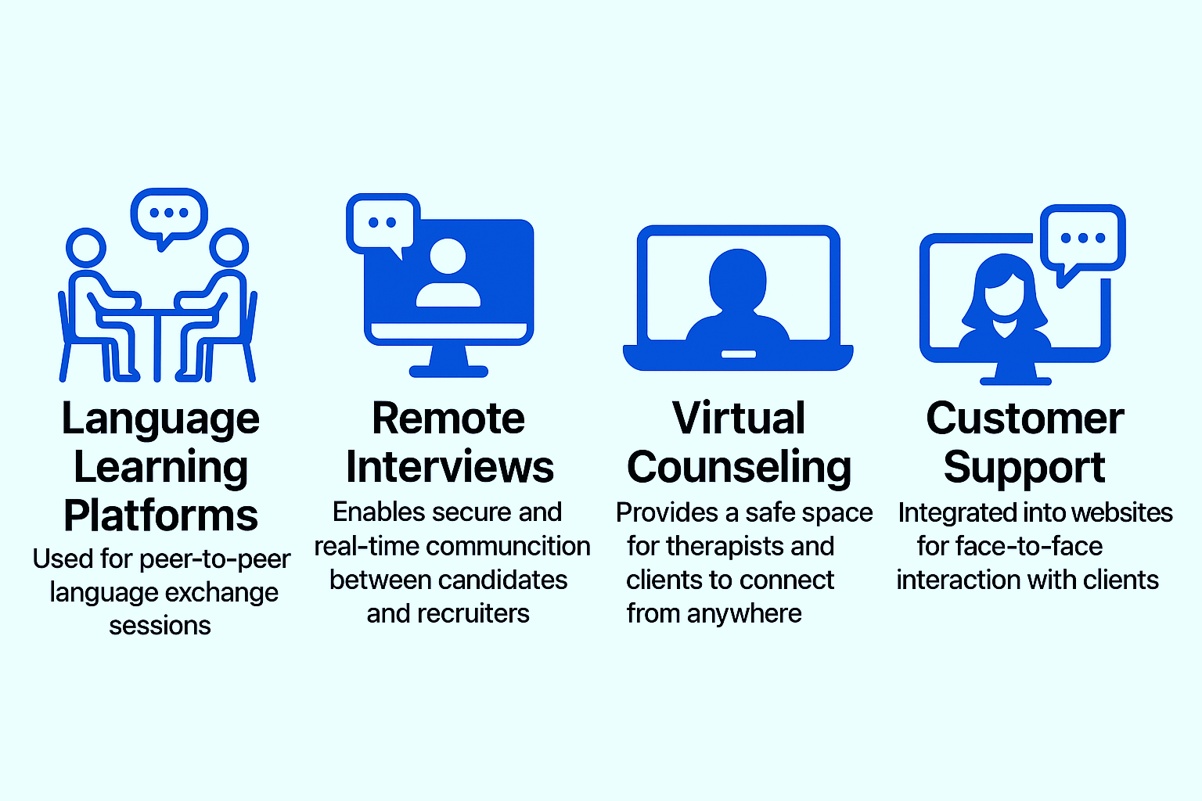
CASE STUDIES AND APPLICATIONS
12
Notes:
Image source: https://c1.neweggimages.com

Slide 13

BENEFITS
Real-Time Communication: Enables instant video and audio interaction across devices.
User-Friendly Interface: Simplified UI enhances user experience and accessibility.
Secure Authentication: JWT-based login ensures secure access to user sessions.
Scalable Architecture: MERN stack allows easy scaling for future user growth.
Low Latency Streaming: WebRTC ensures smooth and delay-free video calling.
13
Notes:
Image source: https://401ktv.com

Slide 14

CHALLENGES AND LIMITATIONS
Network Dependency: Video quality and call stability degrade on poor internet connections.
Scalability Constraints: Handling multiple users simultaneously can strain server performance.
Security Challenges: Ensuring end-to-end encryption and secure data transfer is complex.
Limited Features: Lacks advanced options like call recording and group video support.
Browser Compatibility Issues: Varying WebRTC support affects cross-platform consistency.
14
Notes:
Image source: https://img.freepik.com

Slide 15

FUTURE SCOPE
Mobile App Development: Extend support to Android and iOS platforms for broader reach.
Group Video Calling: Enable multi-user conferencing with dynamic screen layouts.
Call Recording Feature: Allow users to record and save video calls securely.
AI-Powered Features: Integrate real-time translation, noise suppression, and facial filters.
Cloud Scalability: Shift to cloud infrastructure (e.g., AWS, Azure) for better performance and global access.
15
Notes:
Image source: https://de9znd9hicg5y.cloudfront.net

Slide 16

CONCLUSION
Developed a real-time video chat app using the MERN stack and WebRTC.
Ensured secure communication with JWT authentication and encrypted media streams.
Achieved seamless one-on-one video calling with low latency.
Gained practical experience in full-stack and real-time application development.
Laid a strong foundation for future enhancements like group calls and mobile support.
16
Notes:
Image source: https://4.bp.blogspot.com

Slide 17
THANK YOU!
17
Notes:
Image source: https://img.freepik.com

